Slide 1



Ferroelectricity-induced negative capacitance in microelectronic devices via phase-field simulations and machine learning
Christian Fernandez¹, Jorge Munoz¹, Yadong Zeng³, Prabhat Kumar², Andy Nonaka², Zhi (Jackie) Yao²
The University of Texas at El Paso¹, Lawrence Berkeley National Laboratory², Altair Engineering Inc³
American Physical Society March Meeting 2024 – March 4th, 2024
1

Slide 2


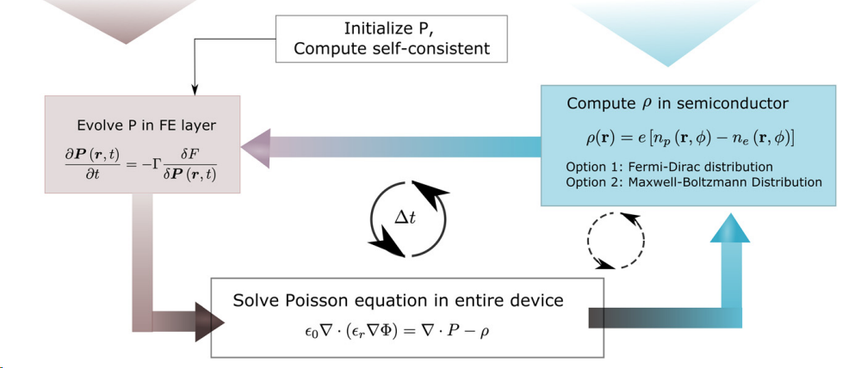
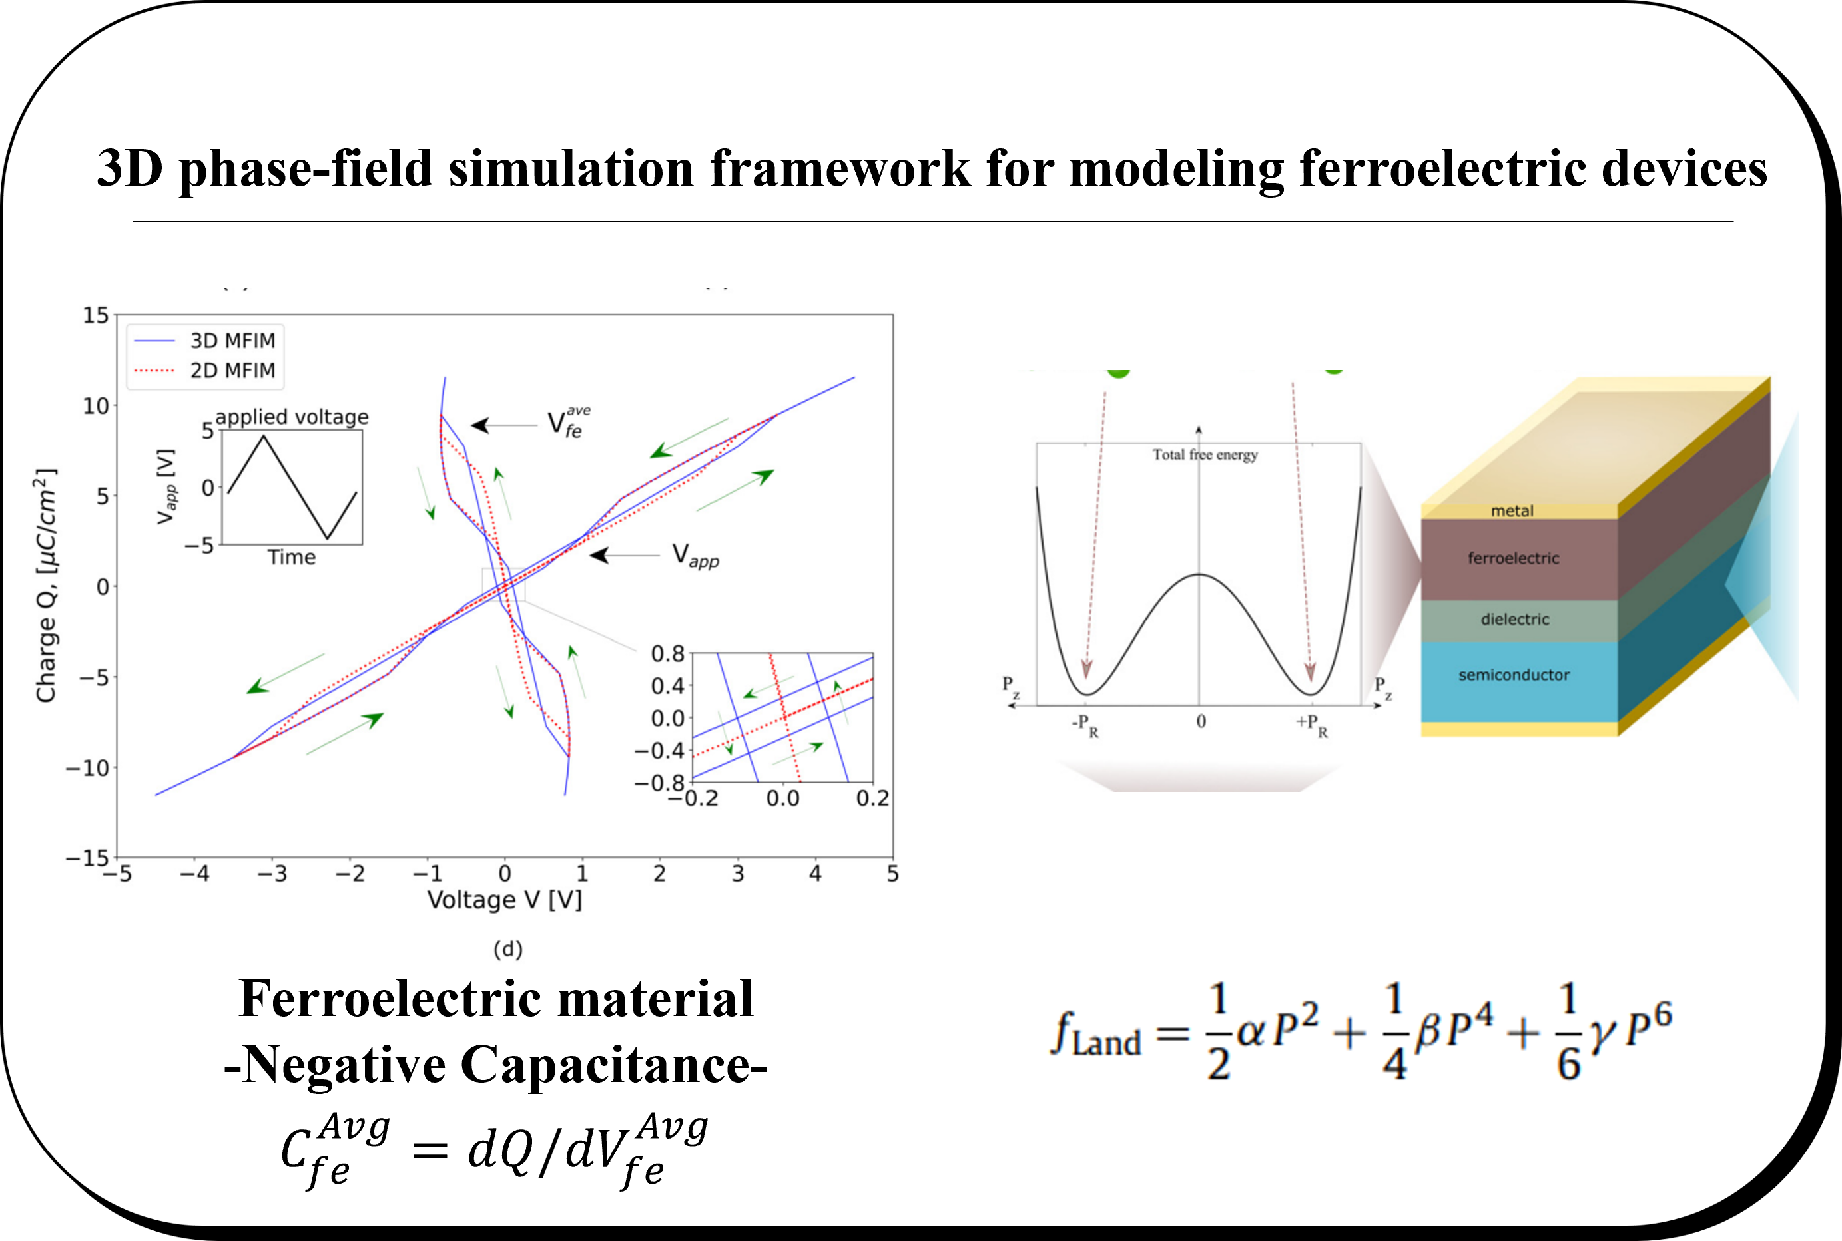
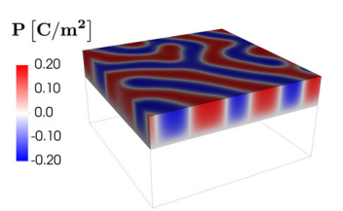
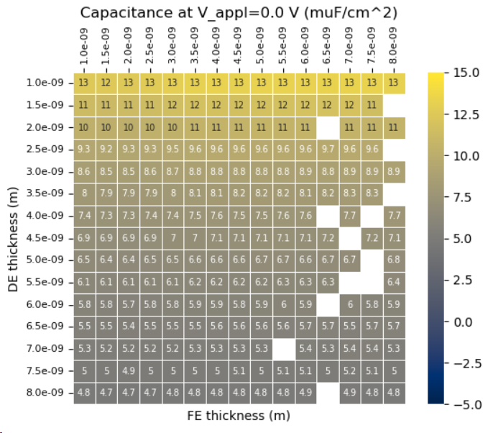
Ferroelectricity-induced negative capacitance in microelectronic devices via phase-field simulations and machine learning
Christian Fernandez¹, Jorge Munoz¹, Yadong Zeng³, Prabhat Kumar², Andy Nonaka², Zhi (Jackie) Yao²
The University of Texas at El Paso¹, Lawrence Berkeley National Laboratory², Altair Engineering Inc³
Introduction
Submit experiments
Generate data
Extract simulations results
Train gaussian model
Trained model
FerroX
FerroX is an open-source software developed by Lawrence Berkeley National Lab for modeling micro-electronic devices based on ferroelectric materials, with the code publicly available on GitHub
Two explored scenarios for experimentation
3D simulations
Low energy consumption electronics
Machine learning
Geometry optimization for the dielectric layer and ferroelectric layer
Negative Capacitance
^{avg}
^{avg}
C_{fe} = dQ /dV_{fe}
Parameter optimizations in terms of alpha, beta and gamma.
Modeling and simulation provided by FerroX are crucial for the development and design of next-generation ferroelectric devices that are energy-efficient.​​
Highly detailed 3D phase-field simulations of next-generation of ferroelectric devices (e.g., memory and logic devices), crucial for capturing the behavior of domain dynamics.
Gaussian process regression was utilized on the data collected to better understand the device parameters’ relation​​.
(Blank slots were not computed.)
Kumar, P., Nonaka, A., Jambunathan, R., Pahwa, G., Salahuddin, S., & Yao, Z. (2023). Ferrox: A GPU-accelerated, 3D phase-field simulation framework for modeling ferroelectric devices. Computer Physics Communications, 290, 108757.
Christian A. Fernandez Soria
Notes:
The negative capacitance measure can be quantified by integrating the interfacial surface charges, which provides a way to evaluate the negative capacitance effect directly from the output of the device. The negative capacitance effect is of interest because it can potentially reduce power consumption and increase the energy efficiency of electronic components such as transistors.

Slide 3
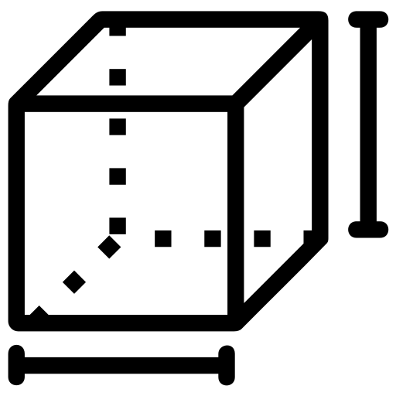
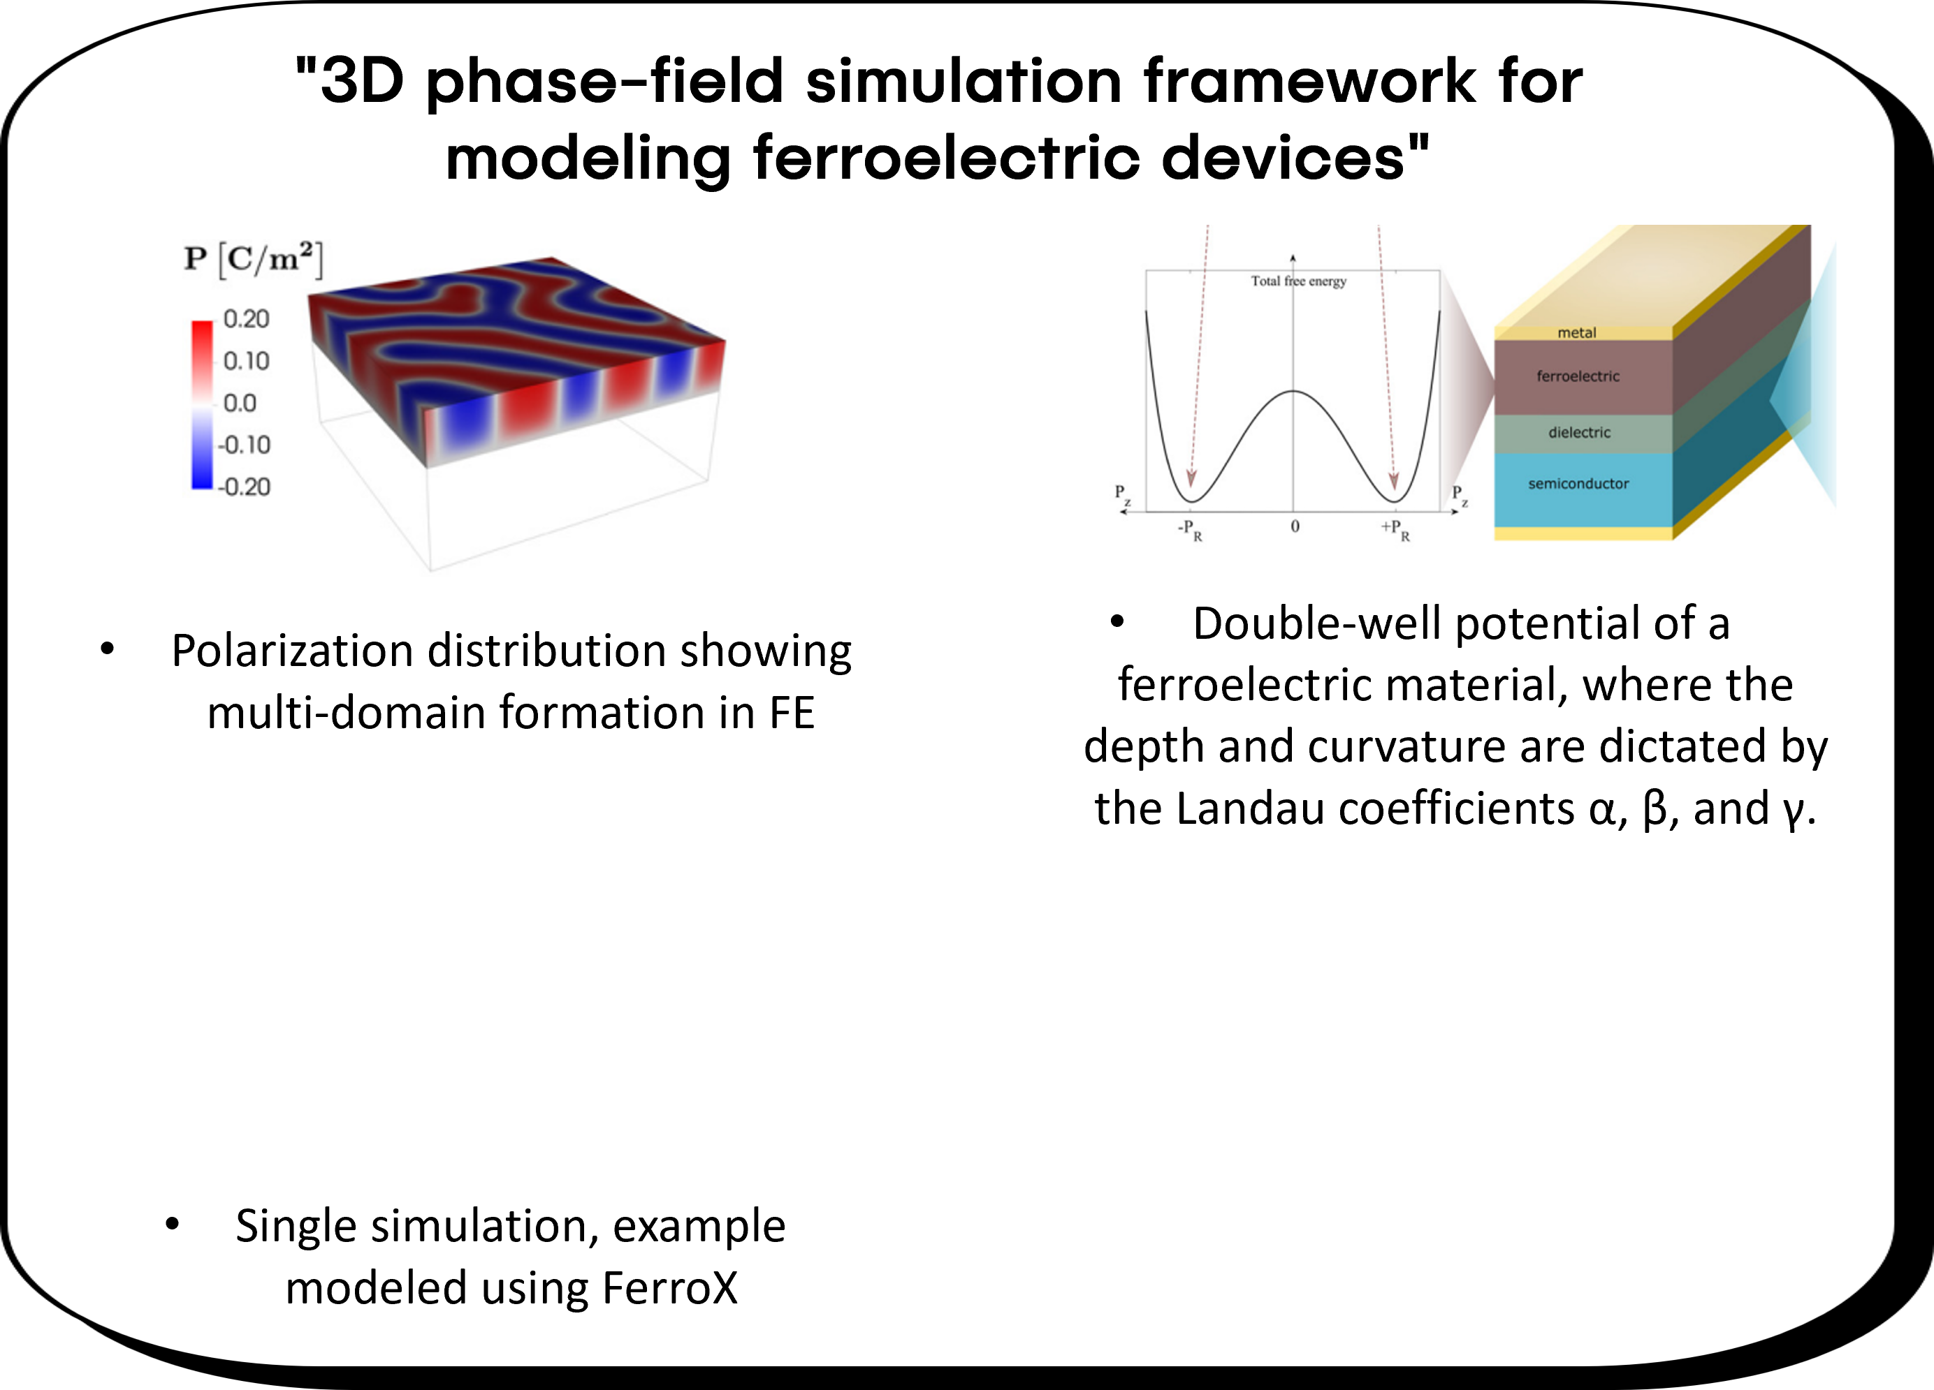
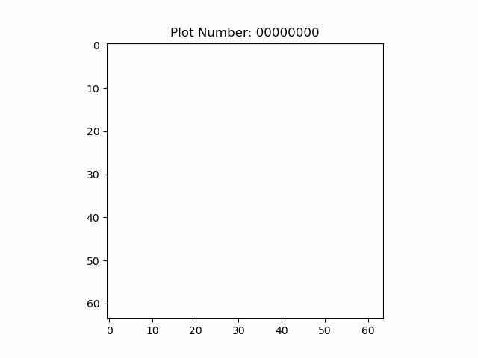

Ferroelectricity-induced negative capacitance in microelectronic devices via phase-field simulations and machine learning
Christian Fernandez¹, Jorge Munoz¹, Prabhat Kumar², Yadong Zeng , Zhi (Jackie) Yao²
The University of Texas at El Paso¹, Lawrence Berkeley National Laboratory2, Altair Engineering Inc³.
Objective
Submit experiments
Generate data
Extract simulations results
Train gaussian model
Trained model
FerroX
Two explored scenarios for experimentation
Minimizing the free energy
Landau-free energy
domain wall energy
the electric energy
FerroX is an open-source software developed by Lawrence Berkeley National Lab for modeling micro-electronic devices based on ferroelectric materials, with the code publicly available on GitHub
Geometry optimization for the dielectric layer and ferroelectric layer
time-dependent Ginzburg–Landau (TDGL)
P = (Px, P y, Pz) is the electric polarization vector
r = (x, y, z) is the spatial vector
F = is the total free energy of the system as a function of P(r,t)
Material parameter optimization in terms of alpha, beta and gamma.
Poisson’s equation under the electrostatic equilibrium
where ∈ is a spatially-varying permittivity
ρ is the total free charge density
P = polarization vector
Kumar, P., Nonaka, A., Jambunathan, R., Pahwa, G., Salahuddin, S., & Yao, Z. (2023). Ferrox: A GPU-accelerated, 3D phase-field simulation framework for modeling ferroelectric devices. Computer Physics Communications, 290, 108757.
3
Christian A. Fernandez Soria

Slide 4
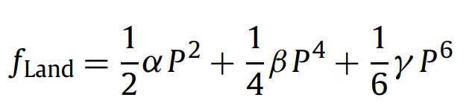
Ferroelectricity-induced negative capacitance in microelectronic devices via phase-field simulations and machine learning
Christian Fernandez¹, Jorge Munoz¹, Prabhat Kumar², Yadong Zeng , Zhi (Jackie) Yao²
The University of Texas at El Paso¹, Lawrence Berkeley National Laboratory2, Altair Engineering Inc³.
Objective
Submit experiments
Generate data
Extract simulations results
Train gaussian model
Trained model
FerroX
Two explored scenarios for experimentation
FerroX is an open-source software developed by Lawrence Berkeley National Lab for modeling micro-electronic devices based on ferroelectric materials, with the code publicly available on GitHub
Geometry optimization for the dielectric layer and ferroelectric layer
Material parameter optimization in terms of alpha, beta and gamma.
Kumar, P., Nonaka, A., Jambunathan, R., Pahwa, G., Salahuddin, S., & Yao, Z. (2023). Ferrox: A GPU-accelerated, 3D phase-field simulation framework for modeling ferroelectric devices. Computer Physics Communications, 290, 108757.
Christian A. Fernandez Soria

Slide 5
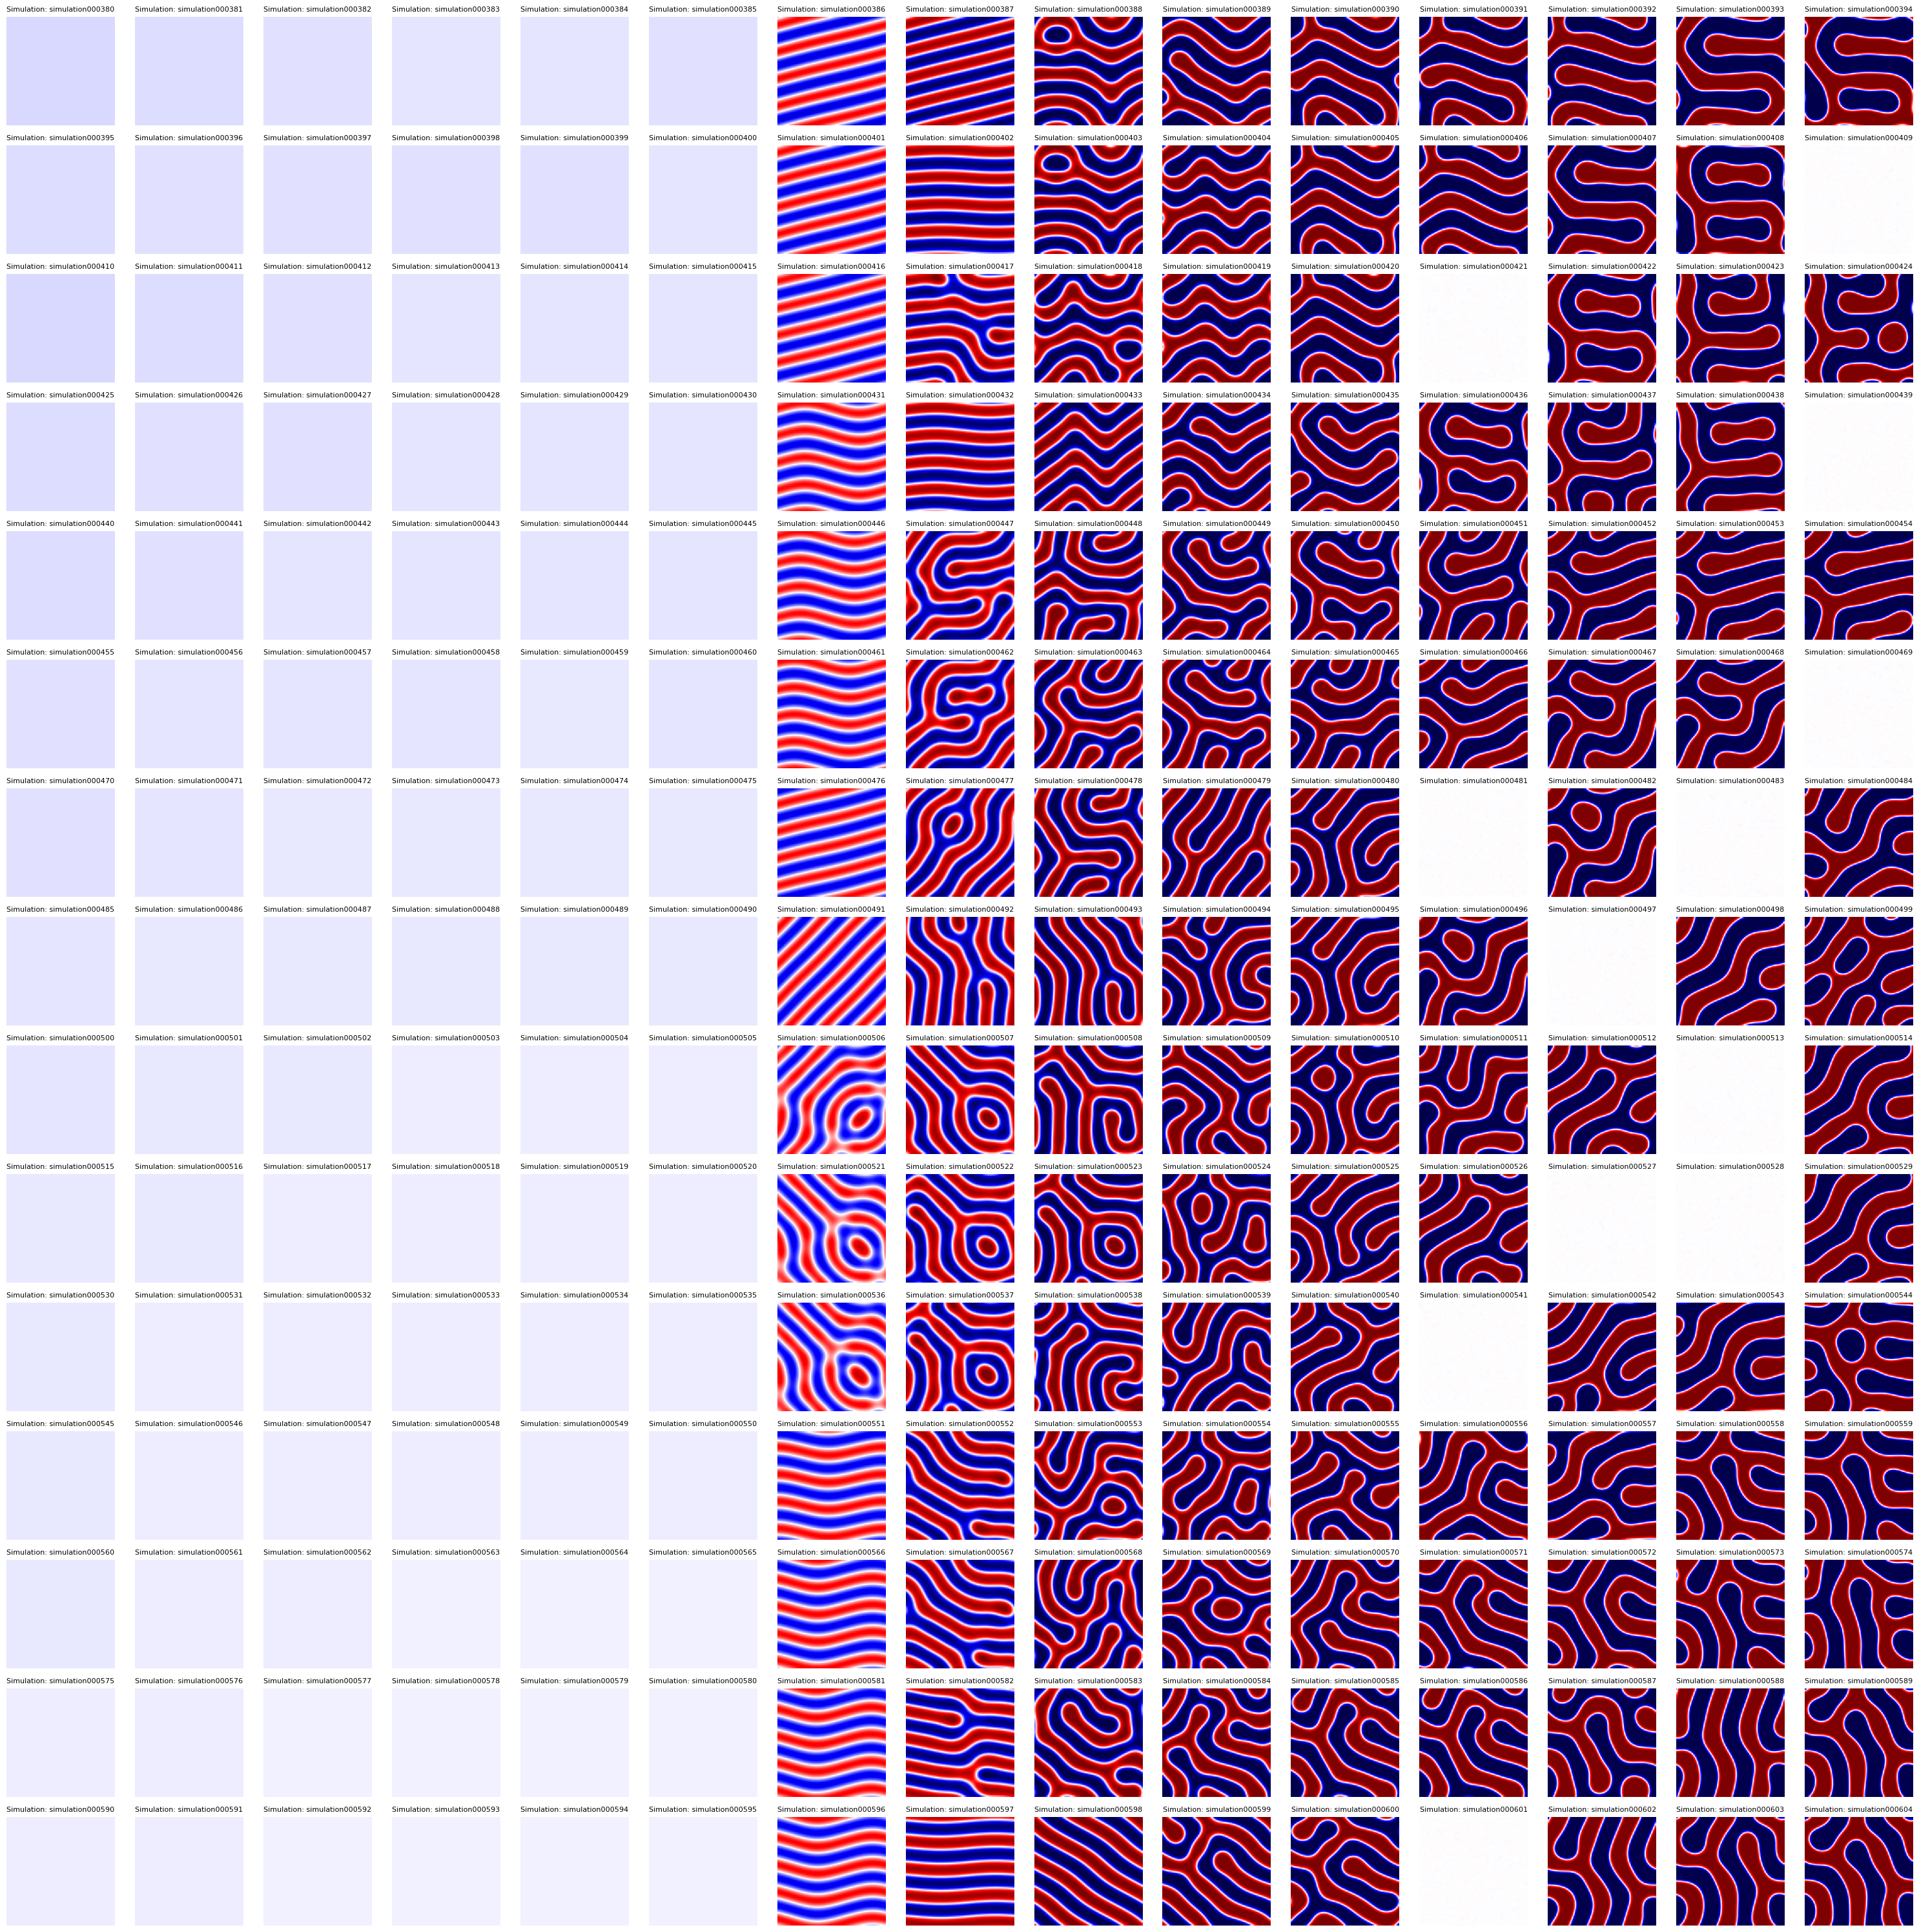
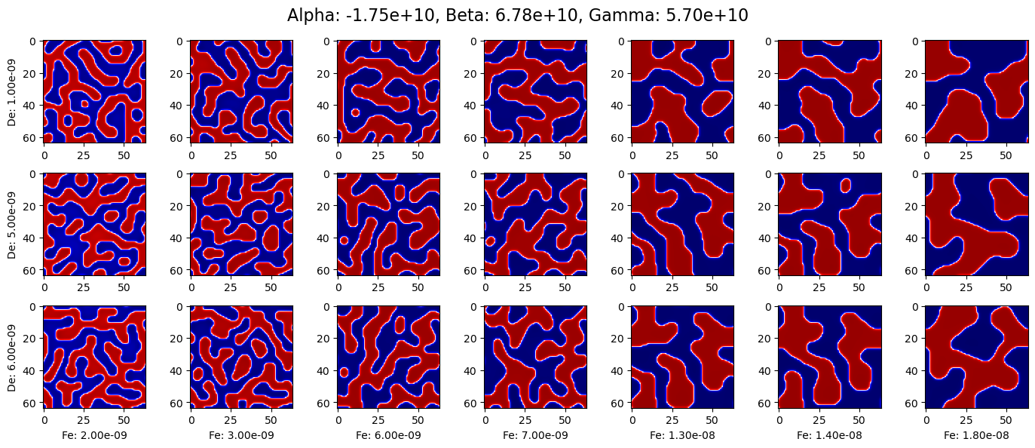
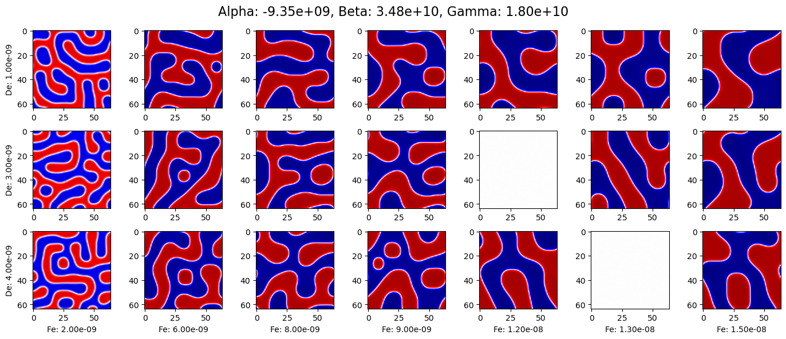
Studies
Submit experiments
Generate data
Extract simulations results
Train gaussian model
Trained model
We mainly explore two scenarios for experimentation
"3D phase-field simulation framework for modeling ferroelectric devices"
Geometry optimization for the dielectric layer and ferroelectric layer
Study of Ferroelectric & Dielectric Thickness DE between 1 and 8 nm, FE from 1 to 8 nm, both every half a nanometer, with four calculation cells per nm
Polarization distribution showing multi-domain formation in FE
double-well potential of a ferroelectric material, where the depth and curvature are dictated by the Landau coefficients α, β, and γ.
Material parameter optimization in terms of alpha, beta and gamma.
Simulation of polarization domains illustrating the effects of varying material parameters: alpha, beta, and Gamma, on domain structures and polarization dynamics
Single simulation, example modeled using FerroX
Christian A. Fernandez Soria

Slide 6
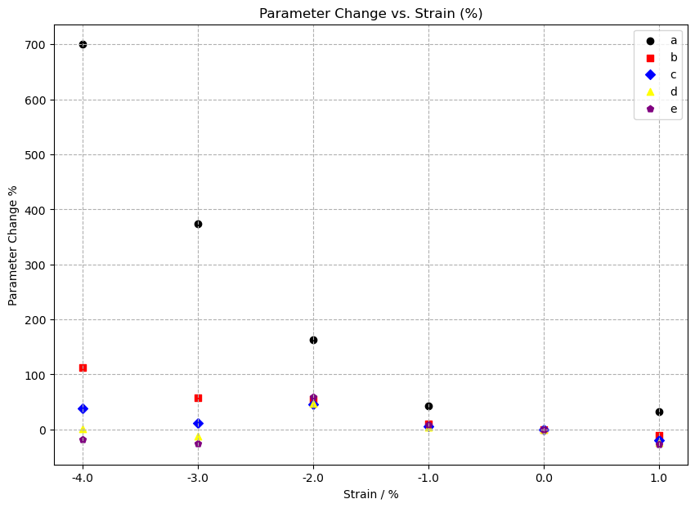
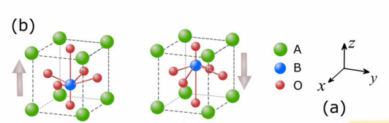
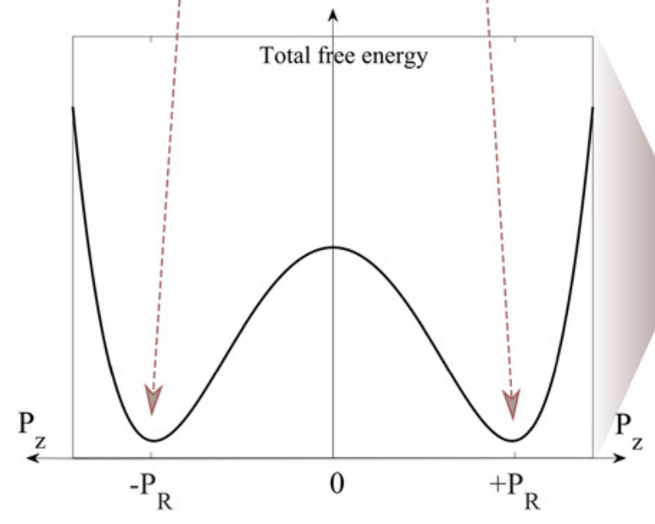
Presentation of this and related work: Understanding and Controlling the Energy Landscape of Hf0.5Zr0.5O2, Presenter: Jack Broad, 5:24 PM–5:36 PM, Room: L100B; Minneapolis & Virtual.
HZO alpha, beta, and gamma parameters were obtained from density functional theory (DFT) calculations.
Studies
Submit experiments
Generate data
Extract simulations results
Train gaussian model
Trained model
The alpha effect on the domain is more appreciable, with a smaller absolute value typically leading to larger, more continuous domains.
Additionally, the thickness of the ferroelectric layer has a pronounced effect, with thinner layers often resulting in more uniform domain structures.
Material parameter optimization in terms of alpha, beta and gamma.
Geometry optimization for the dielectric layer and ferroelectric layer
Study of Ferroelectric & Dielectric Thickness DE between 1 and 8 nm, FE from 1 to 8 nm, both every half a nanometer, with four calculation cells per nm
HZO alpha, beta and gamma parameters on the domain structures and simulation results
Christian A. Fernandez Soria
Parameter optimizations in terms of alpha, beta and gamma.
Simulation of polarization domains illustrating the effects of varying material parameters: Alpha (α), Beta (β), and Gamma (γ), on domain structures and polarization dynamics

Slide 7
Geometry optimization
DFT
Submit experiments
Generate data
Extract simulations results
Train gaussian model
Trained model
Material parameter optimization in terms of alpha, beta and gamma.
Presentation of this and related work: Understanding and Controlling the Energy Landscape of Hf0.5Zr0.5O2, Presenter: Jack Broad, 5:24 PM–5:36 PM, Room: L100B; Minneapolis & Virtual.
HZO alpha, beta, and gamma parameters were obtained from density functional theory (DFT) calculations.
Christian A. Fernandez Soria
The alpha effect on the domain is more appreciable, with a smaller absolute value typically leading to larger, more continuous domains.
Additionally, the thickness of the ferroelectric layer has a pronounced effect, with thinner layers often resulting in more uniform domain structures.
HZO alpha, beta and gamma parameters on the domain structures and simulation results

Slide 8
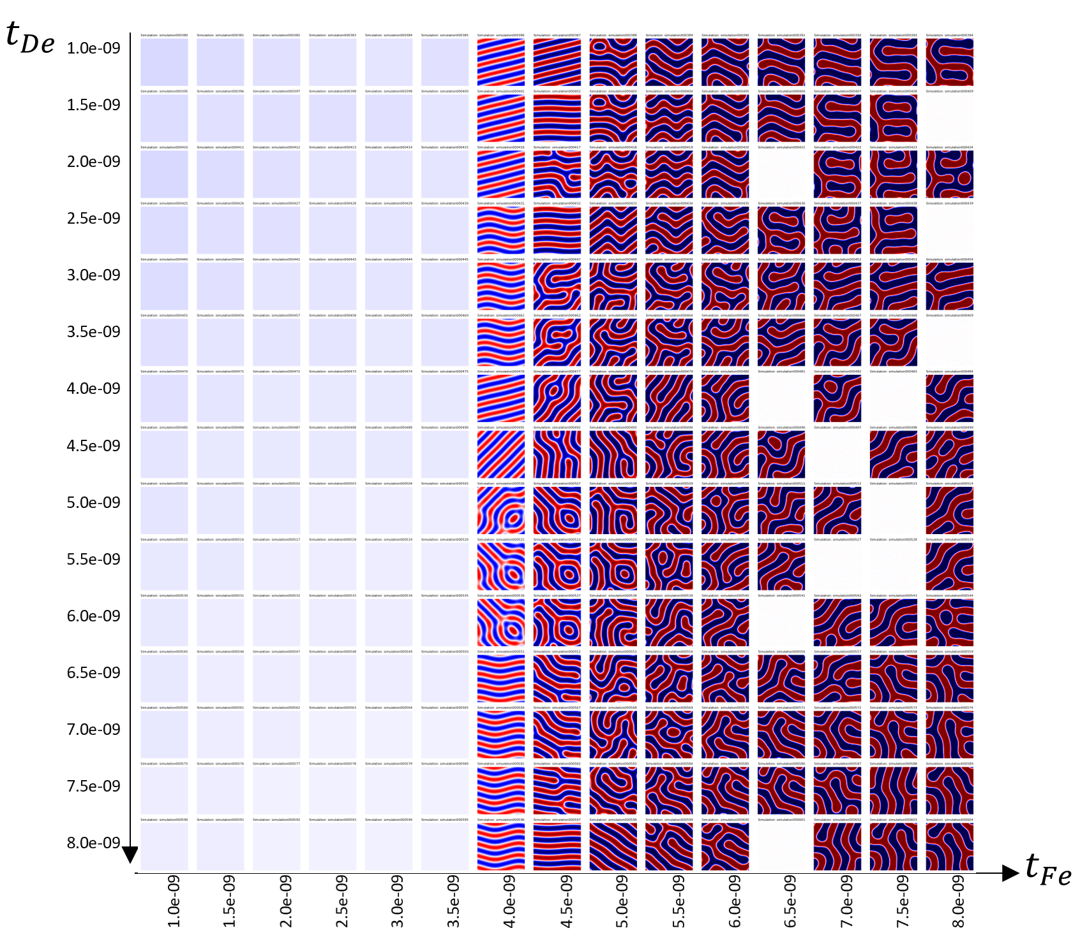
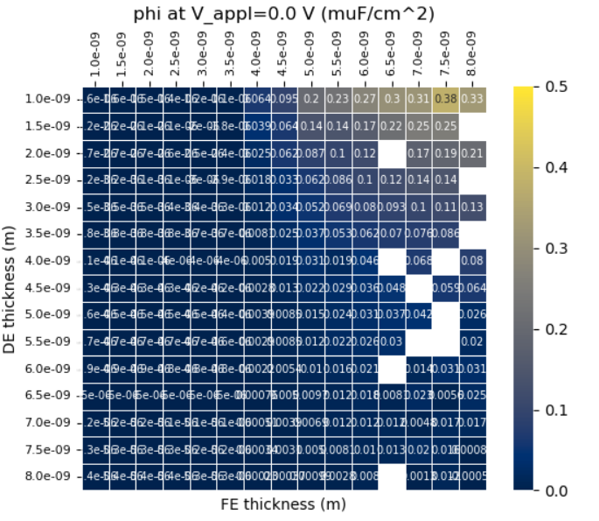
PyFerroX
Geometry optimization
Submit experiments
Generate data
Extract simulations results
Train gaussian model
Trained model
Automated data collection for comprehensive future analyses.
Essential for exploring vast parameter spaces in ferroelectric device simulations.
PyFerroX automates experiment creation for FerroX, enhancing efficiency.
Christian A. Fernandez Soria
Parameter optimizations in terms of alpha, beta and gamma.

Slide 9
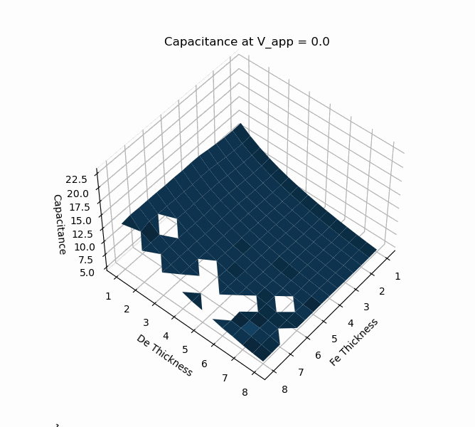
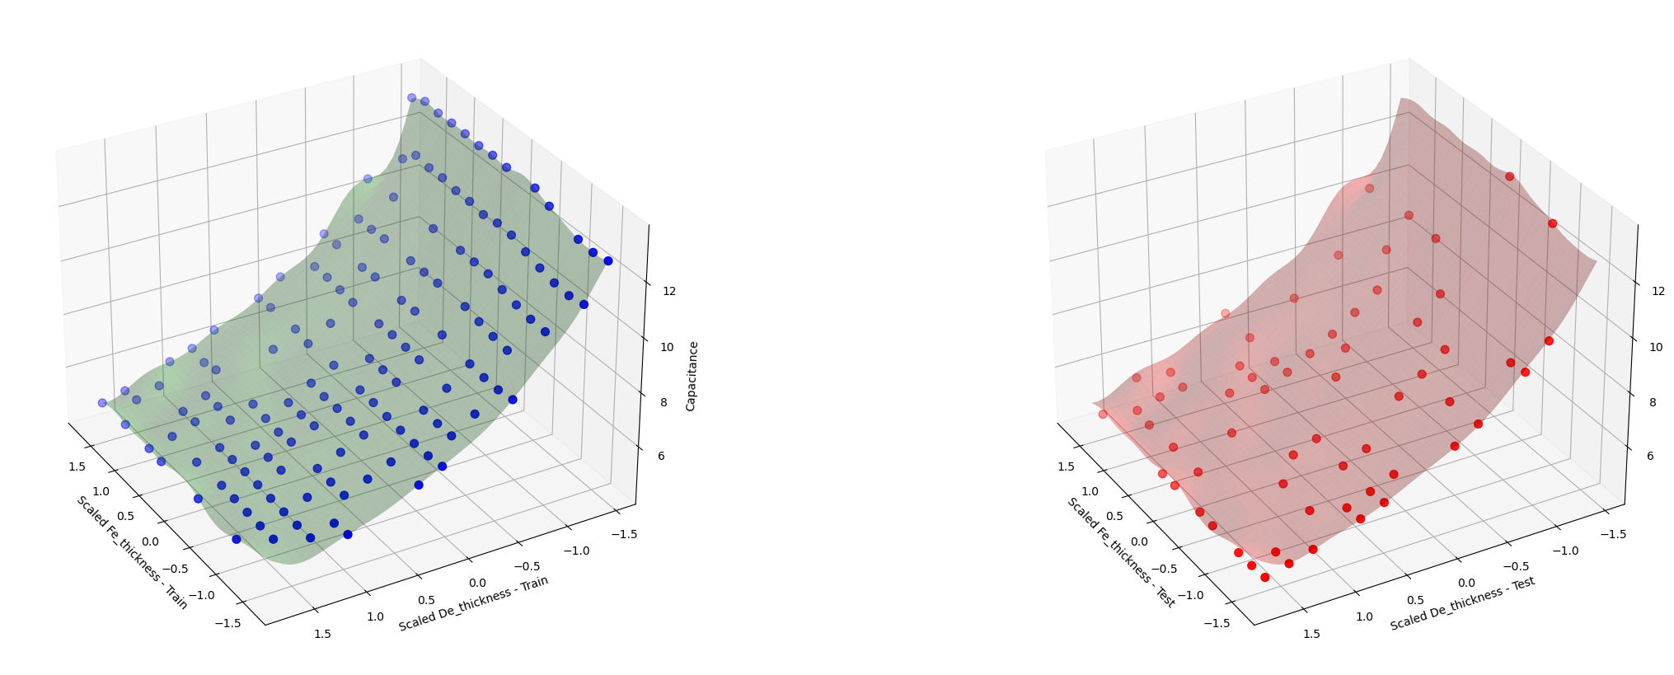
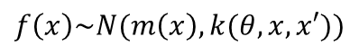
Gaussian process regression
Extract simulations results
Submit experiments
Generate data
Train gaussian model
Trained model
Geometry optimization
Gaussian process prediction
Automated data collection for comprehensive future analyses.
Essential for exploring vast parameter spaces in ferroelectric device simulations.
$$f\left(x\right)\sim N(m\left(x\right), k(θ,x,x′))$$
f(x) is the function we want to predict,
m(x) is the mean function, and
k(x,x′) is the kernel function that defines the covariance between any two function values f(x) and f(x′)
θ: These are the hyperparameters of the covariance function
PyFerroX automates experiment creation for FerroX, enhancing efficiency.
Christian A. Fernandez Soria

Slide 10
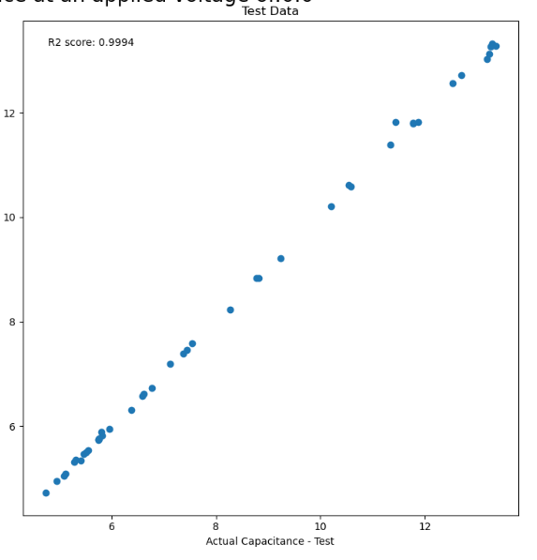
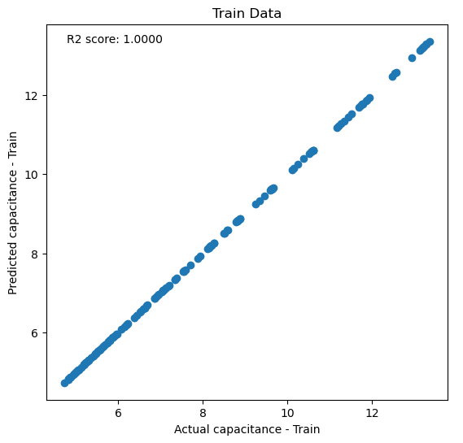
Gaussian process regression
Extract simulations results
Submit experiments
Generate data
Train gaussian model
Trained model
Geometry optimization
Gaussian process prediction
Automated data collection for comprehensive future analyses.
Essential for exploring vast parameter spaces in ferroelectric device simulations.
Predicted capacitance – Test
Gaussian process regression models exhibit exceptional fit with R^2, underscoring their effectiveness in predicting device capacitance and potential electricity across varying ferroelectric and dielectric thicknesses and applied voltages
PyFerroX automates experiment creation for FerroX, enhancing efficiency.
Christian A. Fernandez Soria

Slide 11
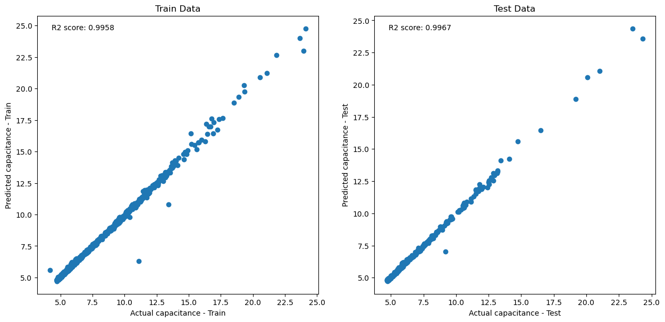
Gaussian process regression
Submit experiments
Generate data
Extract simulations results
Train gaussian model
Trained model
Geometry optimization
Predicted capacitance – Test
Parameter optimization
Simulation of polarization domains illustrating the effects of varying material parameters: Alpha (α), Beta (β), and Gamma (γ), on domain structures and polarization dynamics
Christian A. Fernandez Soria

Slide 12
Gaussian process regression
Submit experiments
Generate data
Extract simulations results
Train gaussian model
Trained model
Parameter optimization
Christian A. Fernandez Soria

Slide 13
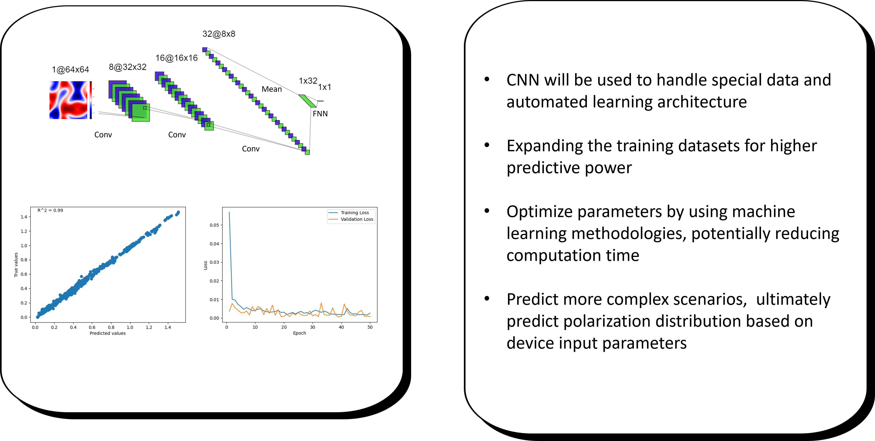
Results and conclusions
Submit experiments
Generate data
Extract simulations results
Train gaussian model
Trained model
Work in progress
High Precision: Gaussian regression models have demonstrated high precision in predicting FerroX results.
In geometry tunning of ferroelectric and dielectric layer, dielectric was demonstrated to have a greater impact on the capacitance of the device.
PyFerroX as an automated workflow allowed optimal and efficient parameters inspection for model training purposes.
A CNN architecture used in this work. Each convolution layer includes a batch normalization and a ReLU activation function (not shown here).
13
Christian A. Fernandez Soria

Slide 14
Convolutional neural network
Submit experiments
Generate data
Extract simulations results
Train gaussian model
Trained model
Work in progress
High Precision: Gaussian regression models have demonstrated high precision in predicting FerroX results.
In geometry tunning of ferroelectric and dielectric layer, dielectric was demonstrated to have a greater impact on the capacitance of the device.
PyFerroX as an automated workflow allowed optimal and efficient parameters inspection for model training purposes.
Thank you!
Thank you!
A CNN architecture used in this work. Each convolution layer includes a batch normalization and a ReLU activation function (not shown here).
14
Christian A. Fernandez Soria

Slide 15
Results and conclusions
Submit experiments
Generate data
Extract simulations results
Train gaussian model
Trained model
Work in progress
Thank you!
Thank you!
15
Christian A. Fernandez Soria

